Slide 1
Learning Social Networks from Web Documents Using Support Vector Classifiers
Authors:
Masoud Makrehchi
Mohamed S. Kamel
Presented By
Abhijeet V. Kulkarni
Pooja Devarajan

Slide 2
Roadmap
Introduction
Related Work
Problem Statement
Proposed Approach
Actor Modeling
Relationship Modeling
Classifier Design for Imbalance Social Networks Data
Performance Evaluation Measure
Data Set
Experimental Results
Conclusion

Slide 3
Introduction
What is a social network?
The goal of a social network is to connect you with people having similar interests, having same majors, common home town, etc.
This paper tries to generate a social network from a collection of web documents.
We have a set of actors(users) and we map every person to a vector space document.
Then we learn the relations between different actors from these vector space documents.
We use SVM for classification.

Slide 4
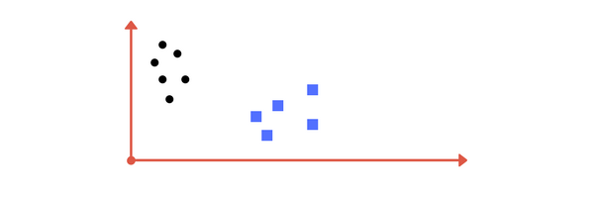
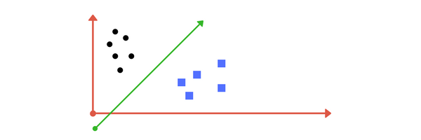
SVM - Overview

Slide 5
Related Work
Text Mining techniques from unstructured textual data.
Pair-wise similarity is extracted from textual resources of individuals.
FOAF database is used as a dataset.

Slide 6
Problem Statement
Having a partially explored social network, predict and learn the rest of the social network.
Let A = {a₁,a₂,…,a_{n}} be the set of actors.
Maximum number of possible relations(ties) are: M = n(n-1) / 2
But in reality the social network is extremely sparse.
The sparsity of a network is given by: S = 1 – (2r / n-1)
Social networks are represented by adjacency matrix.
Let T = {t₁, t₂,….,t_{q}} be the set of incomplete known relations.
Let D = {d₁, d₂,…,d_{n}} be the set of actors textual documents.

Slide 7
Proposed Approach: Learning social Network from Incomplete network
4.1 Actor Modeling
An actor is represented by a set of documents like Resume, portfolio, etc.
All these documents are mapped to a single document vector.
In this vector space representation of an actor, each user is represented by a set of terms.
The global weights are calculated by local weighting and global weighting technique. We use tf-idf for calculating the weights.
Latent semantic indexing is used to model actors.

Slide 8
4.2 Relationship Modeling
Modeling relation between actors:
Estimate similarity of their document vectors
Aggregate the document vectors of the actors
Aggregating :
Aggregate using MIN, MAX and PRODUCT.
We use MAX operator in this paper.
Relation Vector: (Aggregated document vector)
ti,j = { max(wik, wjk)|1 ≤ i, j ≤ n, 1 ≤ k ≤ m}
MAX shows the closeness between two vectors.
Represents the relation instead of the vectors

Slide 9
4.3 Classifier Design for Imbalance Social Network Data
n actors in a social network contribute to
M = n(n-1)/2 possible relations
Every relation is denoted by a document vector.
Problem of social networking is translated into a text categorization problem.
Labels in this model – 0,1
1-relation or connected link , 0- no relation or broken link
T - Set of aggregated documents
C – Set of classes {0,1}
H – Some ideal classifier, H: D -> C (many to one)
Training sample employed to build the model : T ⊆ T

Slide 10
4.3 Classifier Design for Imbalance Social Network Data
Resulting model is H is a good approximation of H.
Optimize H to get highest generalization ability by minimizing the test error.
q relations out of M possible relations are known.
M-q relations are predicted using a classifier like SVM.
(Sparsity) Among M relations very few are connected, (i.e) they belong to class 1.
From (1) : r relations are only positive, remaining M-r are negative.
r : M-r (class imbalance) approximation is r : M ( Since r<<M)
Focus is only on the connected ties.
Minority up-sampling or Majority down-sampling

Slide 11

4.4 Performance Evaluation Measures
Classification accuracy doesn’t work in the case of class imbalance.
Precision , Recall and F-score
Why F-score ?
Micro averaged and macro averaged F-measure used for performance of classifier for both classes.
2 fold cross validation for estimating classifier performance. (macro avg)

Slide 12
Data Set
FOAF Database:
Relations between the individuals
Any web resource addresses and URLs related to the individuals.
34, 275 individuals having 33, 419 ties out of 587, 370, 675 possible relationship.
Sparsity - %99.99, Unbalanced (1 : 17,575) classification problem.
Solution
To break database into small sub graphs.
Check the following graphs

Slide 13
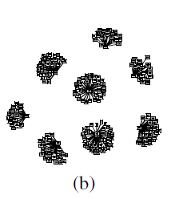
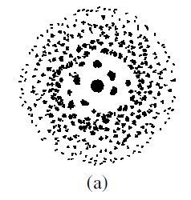
Data Set
Figure 1. FOAF data set, (a) all social networks,
(b) a subset of FOAF data set.

Slide 14
Data Set
1-a
2,933 actors, which build some social networks with 2,641 ties out of 42, 99,778 relations.
Sparsity - %99.94, class imbalance is 1 : 1,627.
1-b
Downsized again.
254 actors, which are interconnected by 246 ties out of 32,131.
Sparsity - %99.21, class imbalance is 1 : 130

Slide 15
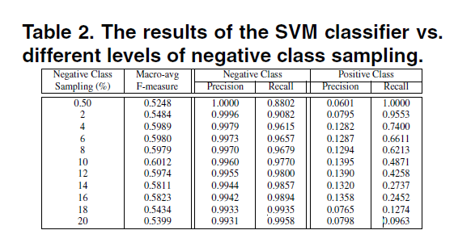
Experimental Result
Negative down-sampling is done to improve the classifier performance.

Slide 16
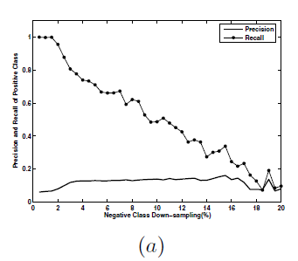
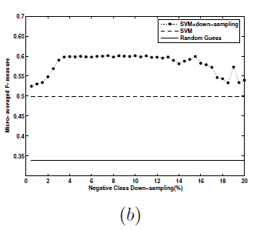
Experimental Result
We increase percentage of majority class, recall linearly drops while precision remains almost constant.
Figure 2. The classifier performance, (a) Precision and recall of positive class vs the percentage of negative class sampling, (b)Macro-averaged F-measure of the classifier vs the percentage of negative class sampling.

Slide 17
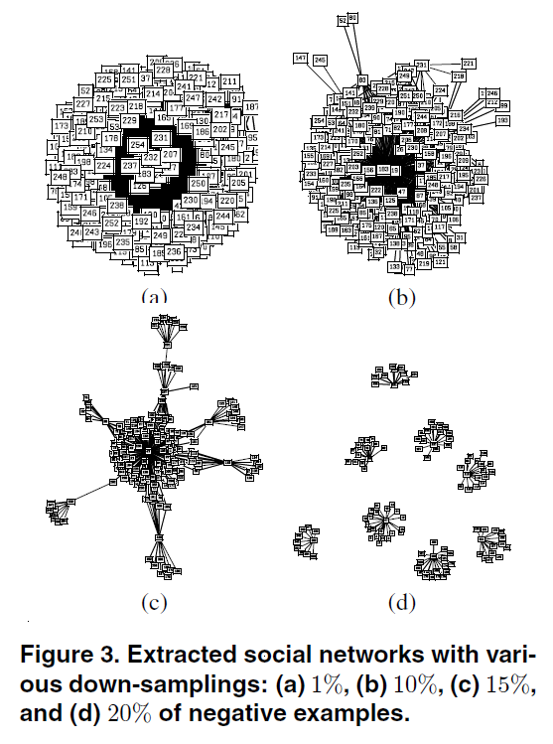
Experimental Result

Slide 18
Conclusion
A text classification formulation to approximately predict social relations using web documents were proposed.
High class imbalance in social networks.
Modeling relation between actors.
Document vector aggregation
Overall macro-averaged F-measure was used to evaluate the extracted social network.
High recall and low precision.

Slide 19

Thank You!!

